Slide 1
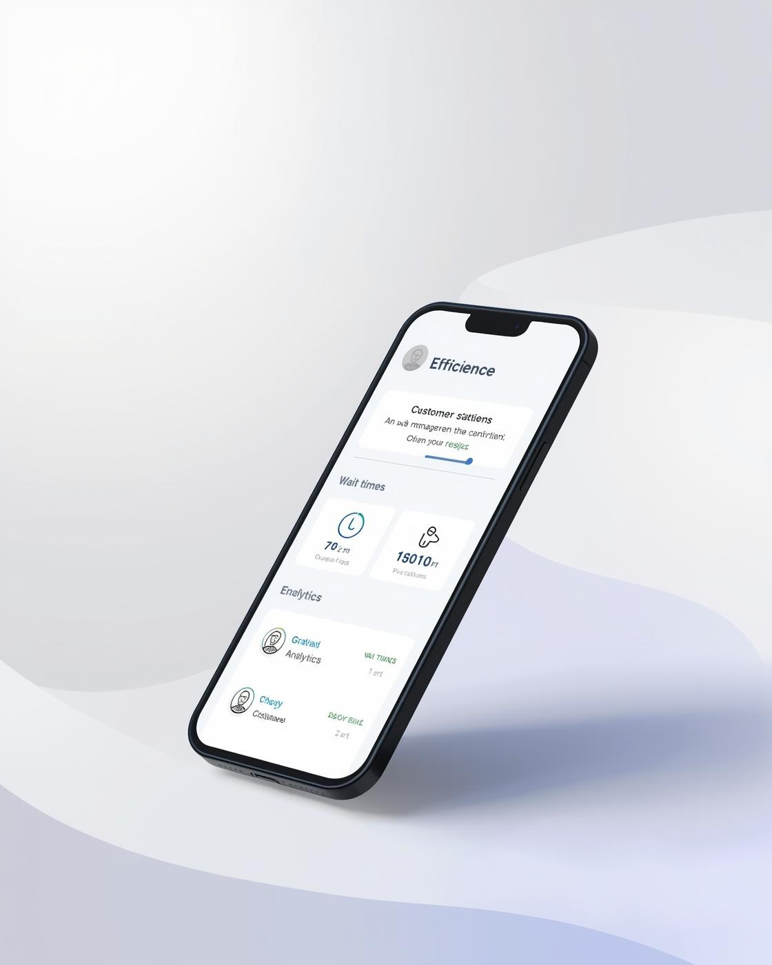

QUEUESENSE
Predict wait-times
PRESENTED BY [PRESENTER NAME]

Slide 2

The Inefficiency of Lines
Unpredictability in Wait Times
Long wait times create stress and frustration, making it difficult for consumers to manage their schedules effectively and causing uncertainty for businesses in planning resources.
Wasted Time and Resources
Inefficient queues lead to significant productivity loss, impacting both customers and organizations as time spent waiting could be better utilized for more valuable activities.

Slide 3
Clinics
Pharmacies
DMV
Patients often face long wait times, leading to frustration and decreased satisfaction in healthcare services.
Prescription pickups can create bottlenecks, wasting valuable time for customers and staff alike in pharmacies.
The DMV is notorious for extended wait periods, leaving individuals feeling overwhelmed and unproductive during visits.
Campus Offices
Retail/Service Centers
Students spend unnecessary hours in long lines at campus offices, impacting their academic schedules and productivity.
Busy retail environments also experience inefficient queuing, resulting in lost sales opportunities and dissatisfied customers.
Real-World Inefficiencies in Queuing Systems

Slide 4
Rough Estimates
Outdated Systems
Existing tools often rely on inaccurate estimations, leading to frustration and inefficiency for both consumers and businesses.
Many organizations still use legacy systems that lack integration, resulting in poor communication and visibility of wait times.
Existing Tools Challenges

Slide 5
Introducing QueueSense
The future of wait-time management solutions
QueueSense offers a revolutionary platform that harnesses real-time and predictive analytics, enhancing both consumer experiences and organizational efficiency across various industries.

Slide 6
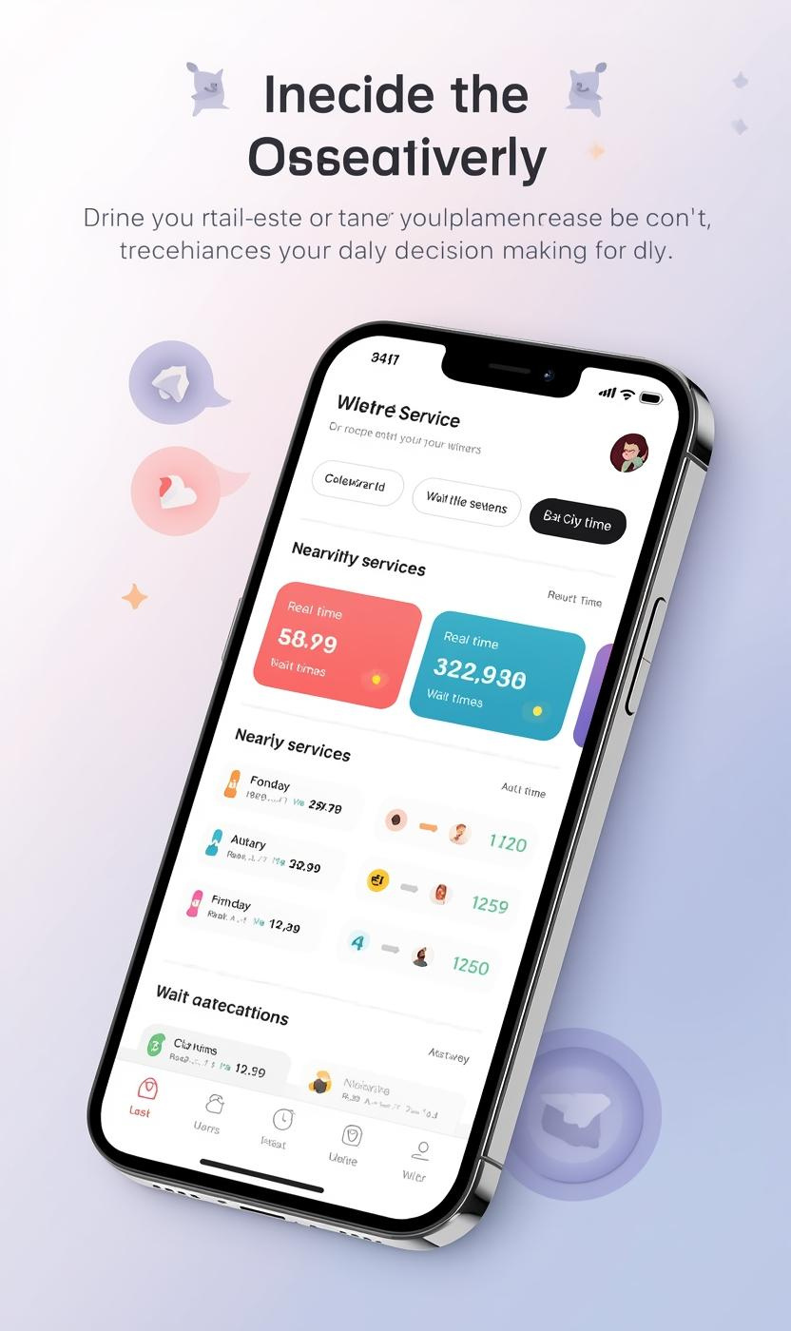
Home Dashboard
Instant clarity for daily decisions
The QueueSense Home Dashboard simplifies user choices by providing real-time wait-times and nearby service recommendations.

Slide 7
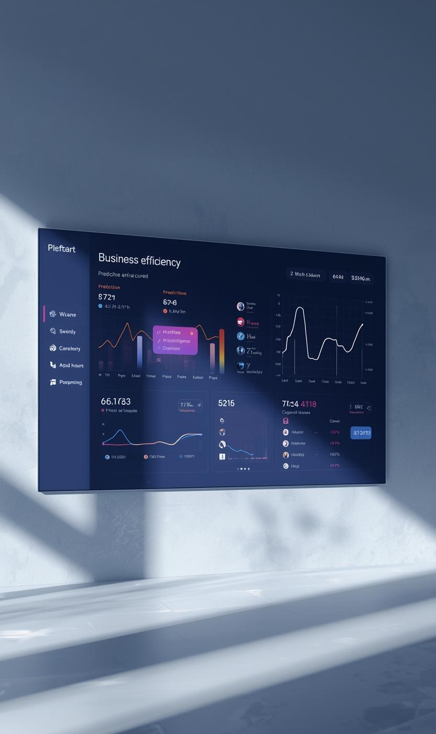
Business Efficiency Dashboard
Operational excellence through predictive insight
This dashboard provides critical analytics for lobby load and staffing patterns, enhancing organizational efficiency and effectiveness.

Slide 8
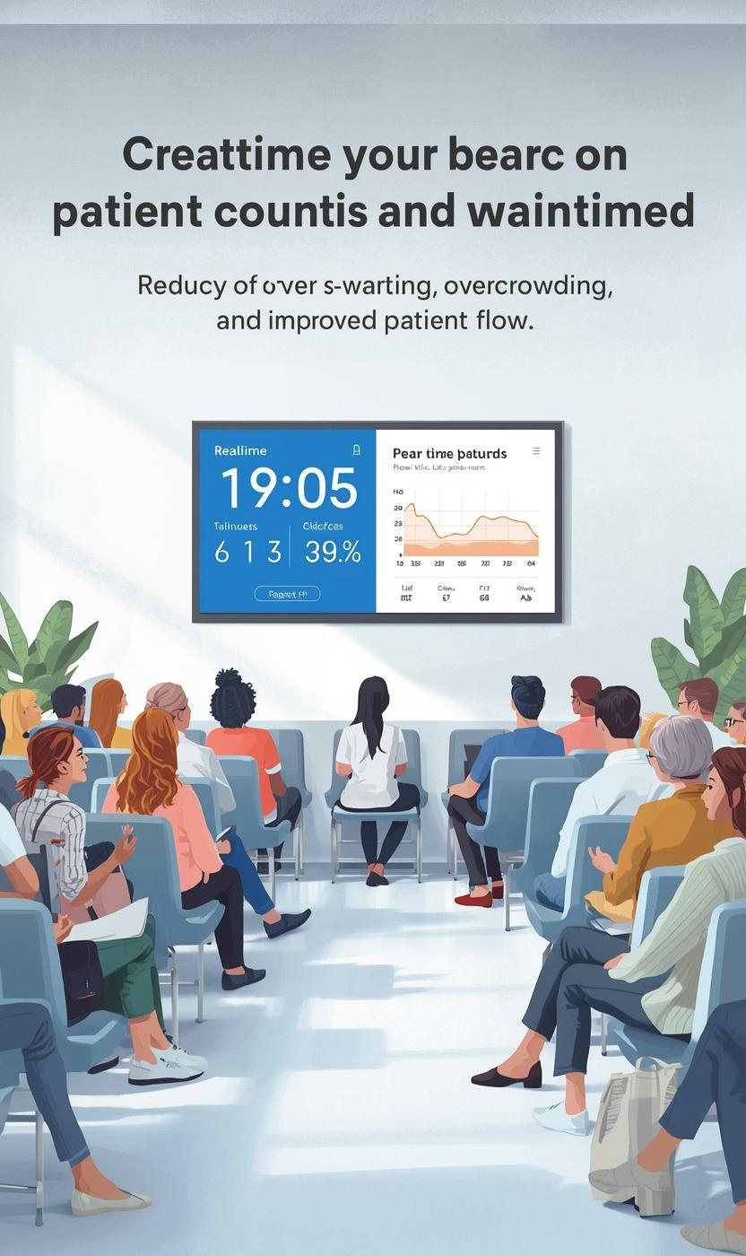
Clinic Wait-Time View
Reduce overcrowding and improve patient flow
This view illustrates real-time patient counts and predictions, enhancing operational efficiency in the clinic environment.

Slide 9
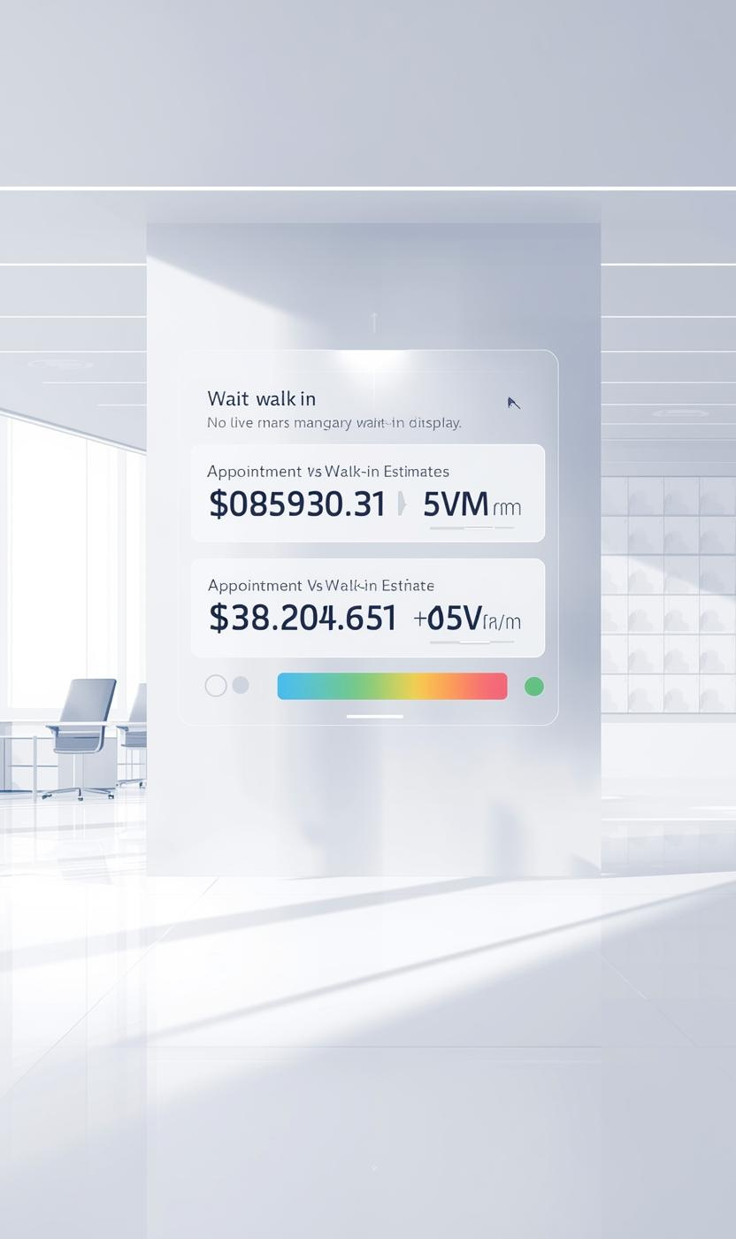
Government/DMV View
Bring order to chaotic service environments
This illustration captures the dynamic wait-time experience, showing live updates that enhance customer efficiency and satisfaction.

Slide 10
Dynamic Alerts
Personalized Recommendations
Receive timely notifications about changing wait-times to optimize your schedule and reduce waiting periods.
Get tailored suggestions based on real-time data to enhance your planning and overall efficiency.
Smart Notifications Overview

Slide 11
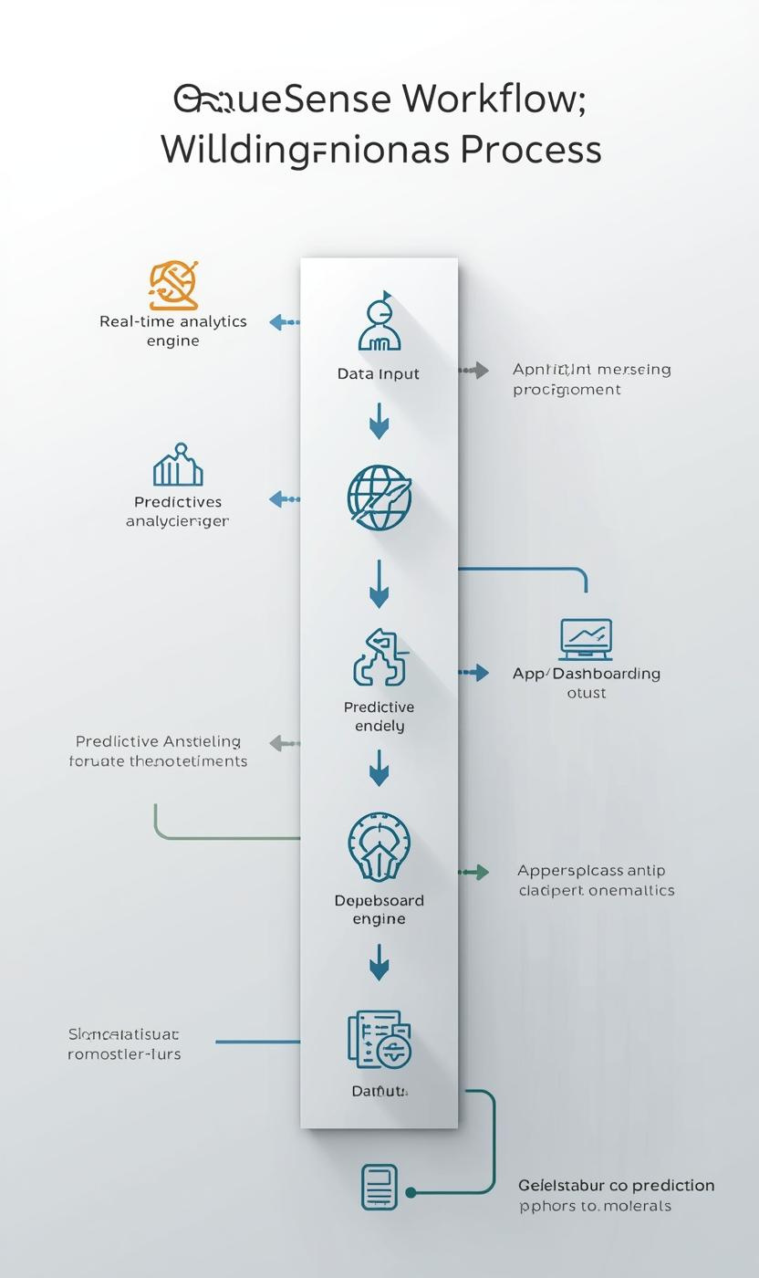
How QueueSense Works
QueueSense operates through a sophisticated data input mechanism that collects real-time information from multiple sources. This data is processed by a robust analytics engine, which analyzes patterns and trends in wait times across various sectors. By utilizing predictive modeling techniques, it provides actionable insights that enhance operational efficiency for businesses and convenience for consumers. The result is a seamless experience that addresses inefficiencies in queues across industries.
The app and dashboard outputs deliver intuitive visualizations of wait-time predictions, allowing users to make informed decisions. Real-time alerts and notifications keep both consumers and organizations updated on changing conditions. This interconnected system not only improves the user experience but also optimizes staffing and resource allocation for businesses. Consequently, QueueSense transforms traditional wait-time management into a proactive strategy that significantly reduces congestion and enhances productivity.

Slide 12
SaaS Tiers
Additional Revenue
QueueSense offers flexible subscription plans tailored for varying business needs: Basic, Pro, and Enterprise tiers.
Premium consumer subscriptions and data insights licensing create supplementary revenue streams for sustainable growth.
Business Model Overview

Slide 13
Healthcare
Government
QueueSense optimizes patient flow, reducing wait-times and enhancing the overall experience for both patients and providers.
Streamlining services at DMV and other agencies, QueueSense helps manage crowds and improve citizen satisfaction and workflow.
Market segments and opportunities

Slide 14
Cross-Industry Platform
Predictive Analytics
QueueSense is the first platform uniting various industries to tackle wait-time inefficiencies seamlessly.
Our innovative use of predictive analytics allows businesses to make informed decisions, optimizing their operations effectively.
Competitive Advantages of QueueSense

Slide 15
Contact QueueSense Team
Email
hello@reallygreatsite.com
Social Media
Phone
@reallygreatsite
123-456-7890

